Slide 1
Introduction
Module 1 – Video 1
Management 405
Prof. Nico Voigtländer · UCLA Anderson
Notes:
This is the first of four short videos for Module 1. In this one I introduce the module and show how the pieces fit together.

Slide 2
Module 1 · Introduction
Introduction
About the instructor
BA in Economics and Environmental Engineering in Berlin/Germany
MSc in Environmental Engineering and Technology Policy from MIT
PhD in Economics in Barcelona
Visiting positions at Harvard, University College London
My research: Why are some countries so rich and others so poor?
Contact information
Email: nico.v@ucla.edu
Management 405 · Module 1 · Basic Concepts and Economic Principles
2
Notes:
A little about me. I trained as an environmental engineer before moving into economics, and my research asks why some countries are rich and others poor. That question is really about incentives and institutions, which is the same machinery we will use on business decisions in this course. My email is on the slide, and it is the right address for anything conceptual.

Slide 3
Module 1 · Introduction
Why Study Economics?
Make better decisions as managers (and as consumers, partners, etc.)
To understand, anticipate, contest, and make economic arguments
Provides the foundation for most of the MBA program (e.g., finance, marketing, strategy)
Management 405 · Module 1 · Basic Concepts and Economic Principles
3
Notes:
You should be excited about this course. I think that studying economics can be useful in a number of respects.
I hope that my class will help you make better decisions in your professional life as well as your personal life.
This is a foundational class for the rest of the MBA program. Many of the other courses that you will take have their foundations in economics: just to mention a few, strategy, marketing, human resources, finance and supply chain management. A solid understanding of economics will help you make the most of those courses.
Last, you will learn how to speak the language of economics. There are lots of economists in the world, in firms, the government and the media. It is helpful to understand them, and to speak their language to communicate with them.

Slide 4
Module 1 · Economic Models
Economic Models
Models are theoretical frameworks that help us understand the world around us.
“All models are wrong, but some are useful” (George Box – Famous Statistician).
Models are like maps: they simplify the complex world to help you navigate it.
Find a model that matches your needs.
Management 405 · Module 1 · Basic Concepts and Economic Principles
4
Notes:
Architects need their rulers. Doctors need their stethoscopes. Economists need their models.
What are economic models? They are theoretical frameworks that help us understand the world around us. You state some assumptions, and through a series of logical steps you reach some conclusions. Sometimes these models are mathematical. Sometimes they come in the form of charts.
Models are always wrong, but sometimes they are useful.
In a sense, economic models are like maps. Maps provide a simplified version of the real world to help us navigate it.
You may want to use a simple map, or a more complicated map, depending on your needs.

Slide 5
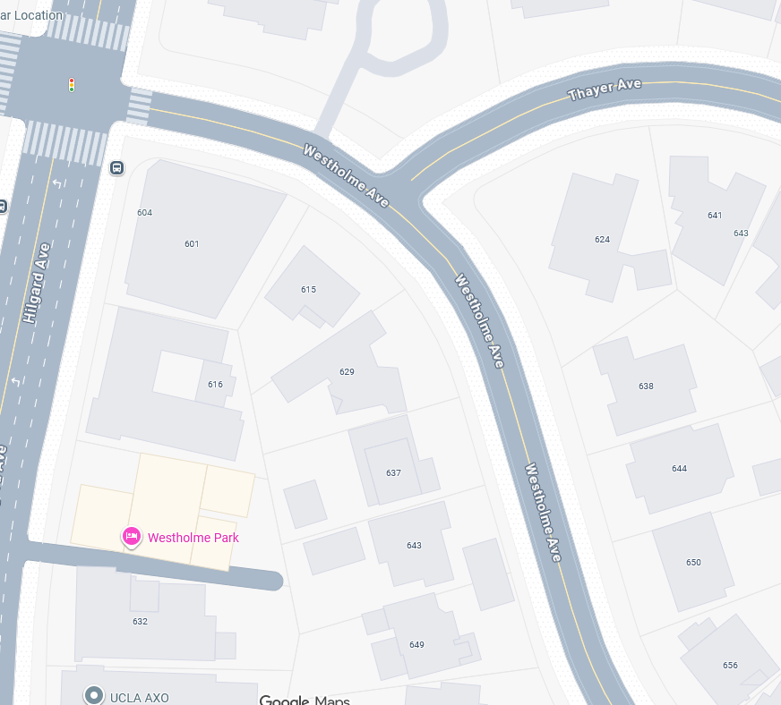
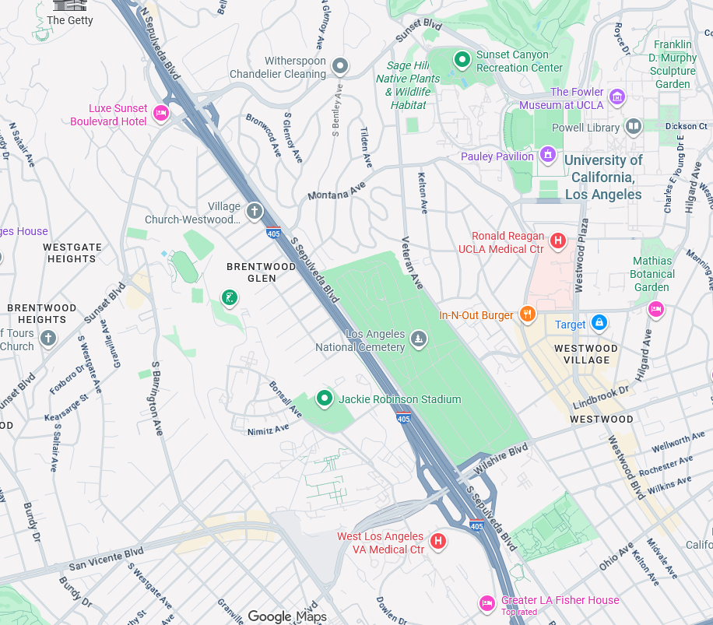
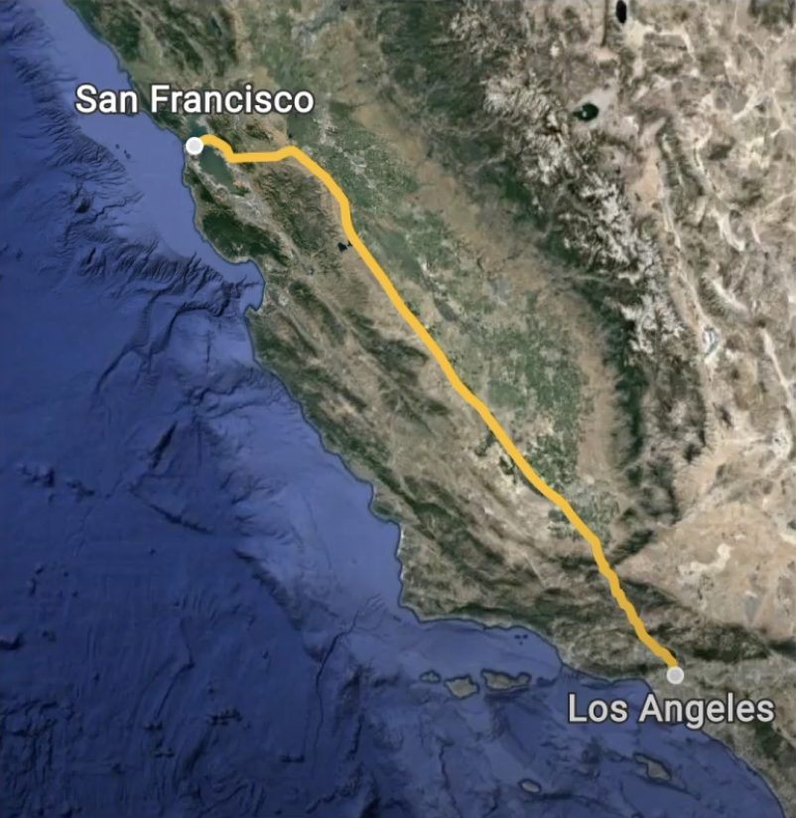
Module 1 · Economic Models
Find a Model That Matches Your Needs
Do you need to drive from LA to SF?
Major routes map
Do you need to get around LA?
LA city map
Do you need to deliver packages in Westwood?
Neighborhood map
Management 405 · Module 1 · Basic Concepts and Economic Principles
5
Notes:
For example, let’s say you need to drive from Los Angeles to San Francisco, you probably should use a map that only shows the major routes. You do not need more detail than that, right? A more detailed map would be more accurate, but less helpful.
If you need to get around Los Angeles, you will probably need a map that shows every street.
And if you need to deliver packages around Los Angeles, you will need even more detail. For example, you would need to know the divisions between houses – you do not want to leave the package in the wrong home.

Slide 6


Module 1 · Introduction
Economists as Hedgehogs
“The fox knows many things, but the hedgehog knows one big thing” (Greek aphorism).
Foxes have different strategies for different problems. They are comfortable with nuance.
Hedgehogs, on the other hand, focus on the big picture. They reduce every problem to one organizing principle.
Management 405 · Module 1 · Basic Concepts and Economic Principles
6
Notes:
The answer is simple: economists are like hedgehogs. Let me explain. Someone once said:
“The fox knows many things, but the hedgehog knows one big thing.” If you think these are the lyrics of a new Lady Gaga song, that’s not it. These words were attributed to the Ancient Greek poet Archilochus, and popularized by the philosopher Isaiah Berlin. This allegory suggests that there are two types of people in the world: the foxes, and the hedgehogs.
On the one hand, foxes have different strategies for different problems. They love nuance, and want to spend all the time in the world to navigate the nitty-gritty of the problem at hand.
Hedgehogs, on the other hand, want to reduce every problem to one organizing principle. They have one universal tool that they will attempt to use no matter what the problem is. This has a clear disadvantage: if you don’t pay attention to nuance, you will make mistakes. However, being a Hedgehog has its advantages too: you can make decisions quickly and with little effort, almost instinctively.

Slide 7
Module 1 · Course Roadmap
Agenda for the Class
1. Basic Principles and Economic Way of Thinking
we are here
2. Value and Demand
3. Supply and Cost
4. Markets, Pricing, and Strategy
Management 405 · Module 1 · Basic Concepts and Economic Principles
7
Notes:
Here is the shape of the whole course. We are in part one, the basic principles and the economic way of thinking, and it feeds everything that follows: value and demand, then supply and cost, then markets, pricing and strategy. Keep this map in mind, because I will come back to it at each transition.

Slide 8
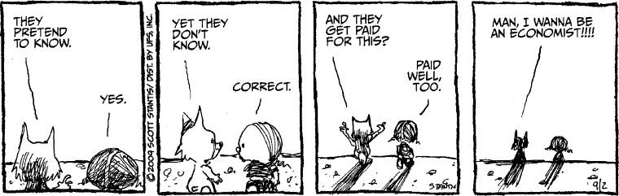
Basic Concepts and Economic Principles for Decision Making
Module 1
Management 405
Prof. Nico Voigtländer · UCLA Anderson
Notes:
Welcome to Module 1. This module lays the foundation for the whole course: what a market is, how supply and demand set prices, and the three principles I want you to carry into every business decision. Let me start with a few words about myself and about how the class will run.

Slide 9
Module 1 · Video 1 · Introduction
Outline of Module 1
1
Markets
Video 2: what a market is, and how far it extends
2
Demand and supply
Video 3: how buyers and sellers each respond to price
3
Equilibrium
Video 4: where demand meets supply, and what moves it
4
Economic costs include opportunity costs
In class: the value of the next-best alternative you gave up
5
Ignore sunk costs
In class: money already spent should not drive the next decision
6
Use cost-benefit and marginal analysis
In class: compare the benefit of the next unit with its cost
Management 405 · Module 1 · Basic Concepts and Economic Principles
9
Notes:
Here are the six topics of Module 1 with a one-line description of each. The first three are covered in the videos, so you can watch them at your own pace. The last three are what we work through together in class.

Slide 10
BACKUP
Notes:
Everything from here is backup material: slides I keep for questions that come up in class, and the targets of the links earlier in the deck. Nothing after this point is part of the main flow.

Slide 11


Module 1 · Backup
People Respond to Incentives
Property tax:
Based on the number of windows
England and Wales (1696 – 1851)
Portland Street, Southampton, UK
← Back
Management 405 · Module 1 · Basic Concepts and Economic Principles
Notes:
This picture provides an excellent example on how to think like an economist. Do you notice anything strange? Some of the windows are missing, right? What could be going on? You may think that this is an error – maybe a terrible architect designed this building and skipped some windows. No, that’s not it. You may guess that this is a weird architectural style you had not heard about. Maybe the missing windows are a symbol for something, right? No, that’s not it either.
So, what is it? Taxes, of course.
In 1696, England introduced a property tax that was based on the number of windows. If your home has more than 10 windows, you have to pay more in taxes. The more windows, the higher the tax bill. This tax was intended to be a progressive tax: richer would pay more in taxes, because they tend to live in bigger houses, with more windows. This tax was also practical: a government employee could just walk to the front of your house, count the number of windows, and that is all of the information needed. No need to find out the number of bedrooms or bathrooms, or to figure out how much your home is worth.
This tax had a terrible drawback though: it was easy to avoid. If you keep the number of windows below 10, you do not need to pay as much in taxes. This is the reason why many homes constructed in England during this period did not have as many windows. And homeowners would go as far as boarding up some of the existing windows to avoid the tax.
Whoever came up with the idea for the windows tax did not think like an economist. By the end of this course, I hope you will not make the same mistake.

